Slide 1
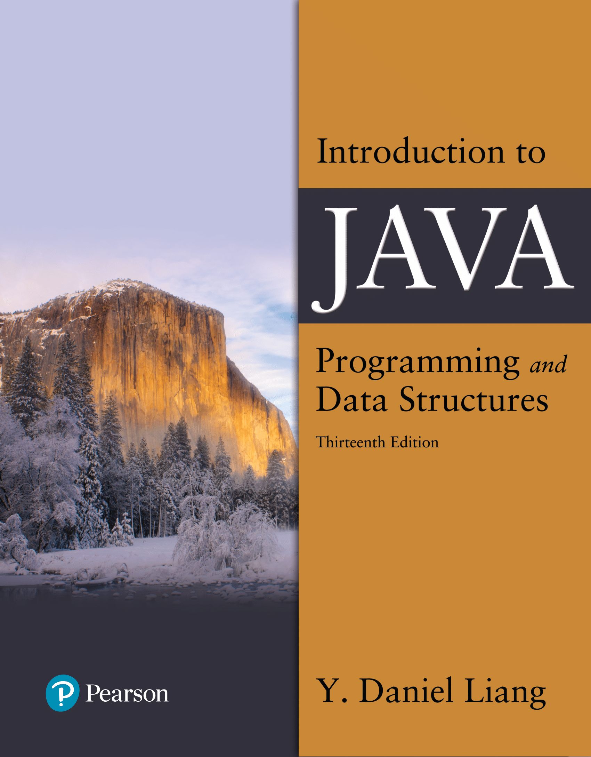

Introduction to Java Programming and Data Structures
Thirteenth Edition
Chapter 5
Loops
Copyright © 2024 Pearson Education, Inc. All Rights Reserved
Notes:
If this PowerPoint presentation contains mathematical equations, you may need to check that your computer has the following installed:
1) MathType Plugin
2) Math Player (free versions available)
3) NVDA Reader (free versions available)
Slides in this presentation contain hyperlinks. JAWS users should be able to get a list of links by using INSERT+F7

Slide 2
Motivations
Suppose that you need to print a string (e.g., "Welcome to Java!") a hundred times. It would be tedious to have to write the following statement a hundred times:
System.out.println("Welcome to Java!");
So, how do you solve this problem?

Slide 3
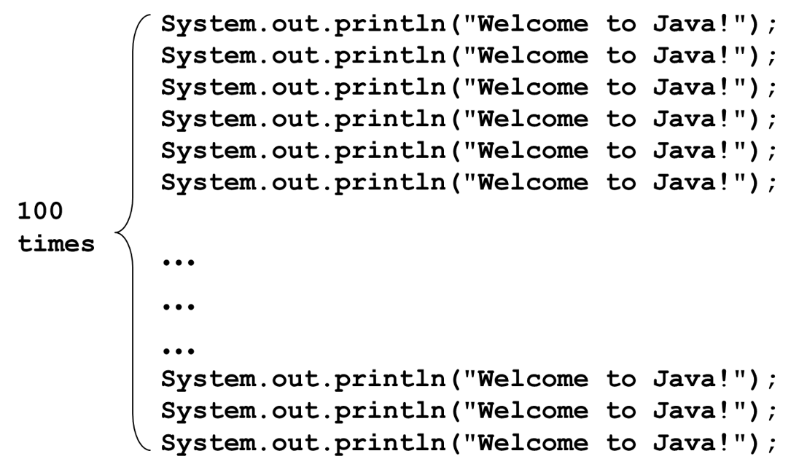
Opening Problem
Problem:

Slide 4
LOOPS
Allows you to repeat block of statements several times.
Java Loops
while loop
do …. while loop
for loops

Slide 5
Counter Loop
Number of iterations are known before execution starts.
Conditional Loop
Number of iterations are unknown before execution starts

Slide 6
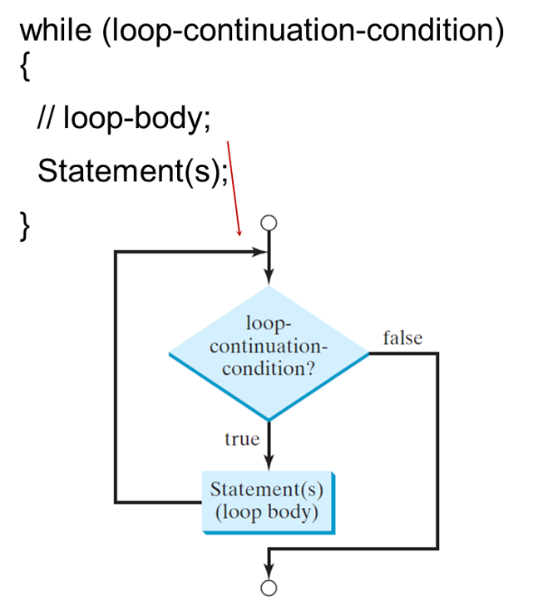
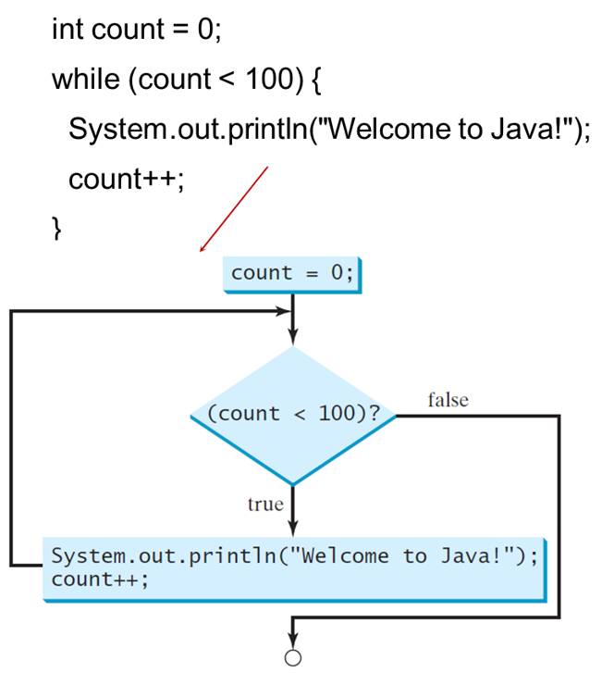
while Loop Flow Chart
Notes:
The chart starts from open circle with downward arrow followed by decision box labeled loop-continuation-condition if false connected to a open circle, if true connected to Statement(s) (loop body). An arrow points Statement(s) (loop body) to downward arrow at the start.
The chart starts from process box that reads count = 0 semicolon, which further connected to decision box labeled open parenthesis count less than 100 close parenthesis question mark, if false connected to a open circle, if true connected to System dot out dot println open parenthesis opening quotation Welcome to Java exclamation closing quotation closing parenthesis semicolon. An arrow points process to start process arrow.

Slide 7
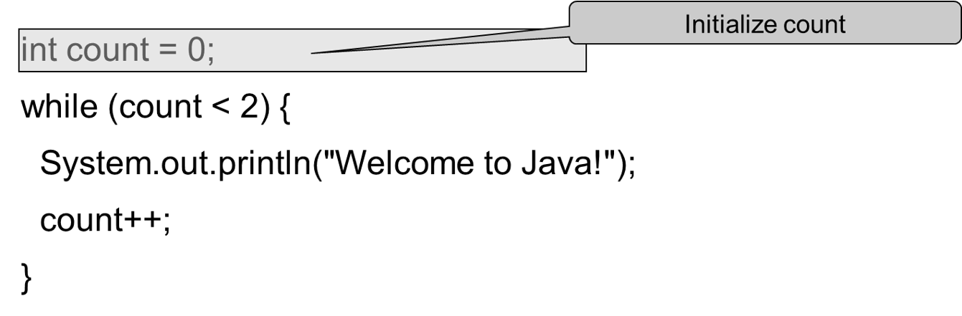
Trace while Loop (1 of 9)

Slide 8
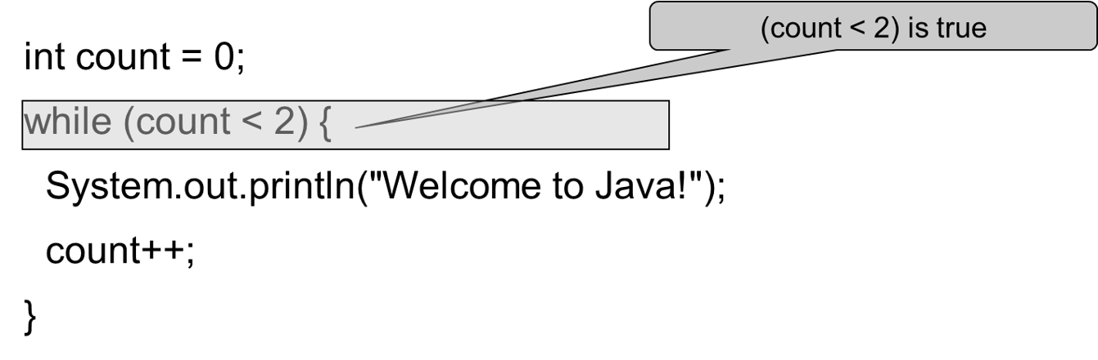
Trace while Loop (2 of 9)

Slide 9
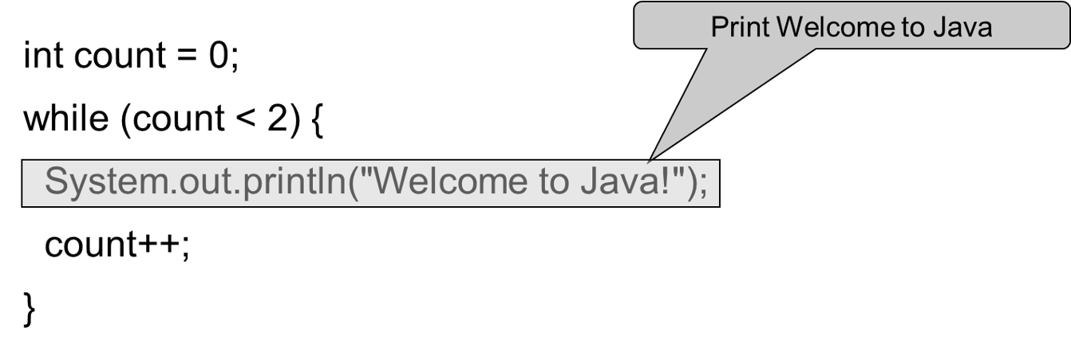
Trace while Loop (3 of 9)

Slide 10
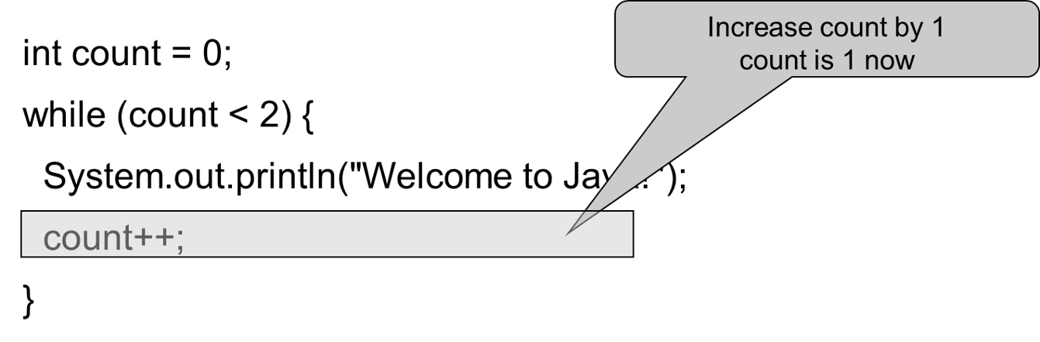
Trace while Loop (4 of 9)

Slide 11
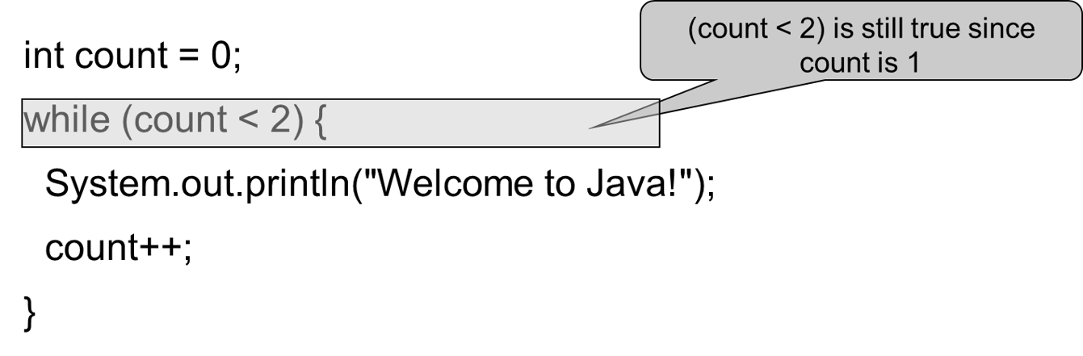
Trace while Loop (5 of 9)

Slide 12
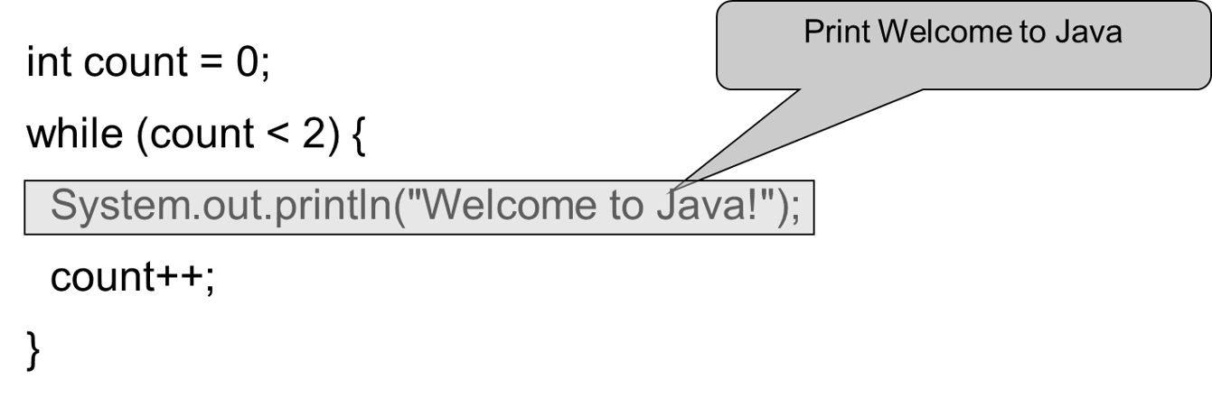
Trace while Loop (6 of 9)

Slide 13

Trace while Loop (7 of 9)

Slide 14
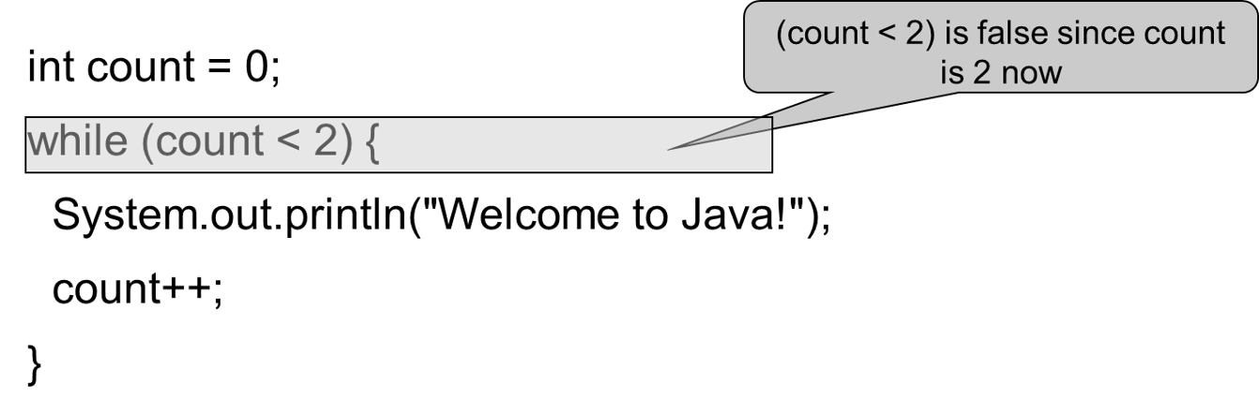
Trace while Loop (8 of 9)

Slide 15
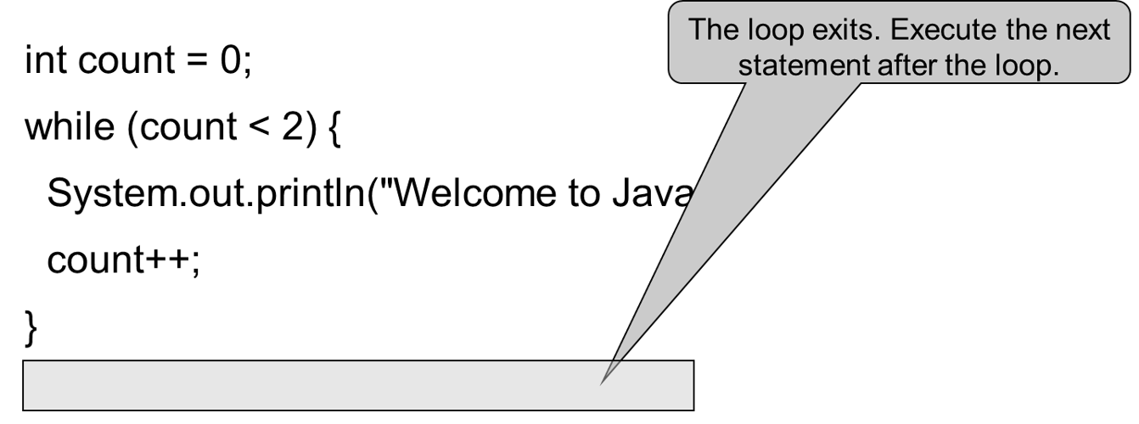
Trace while Loop (9 of 9)

Slide 16
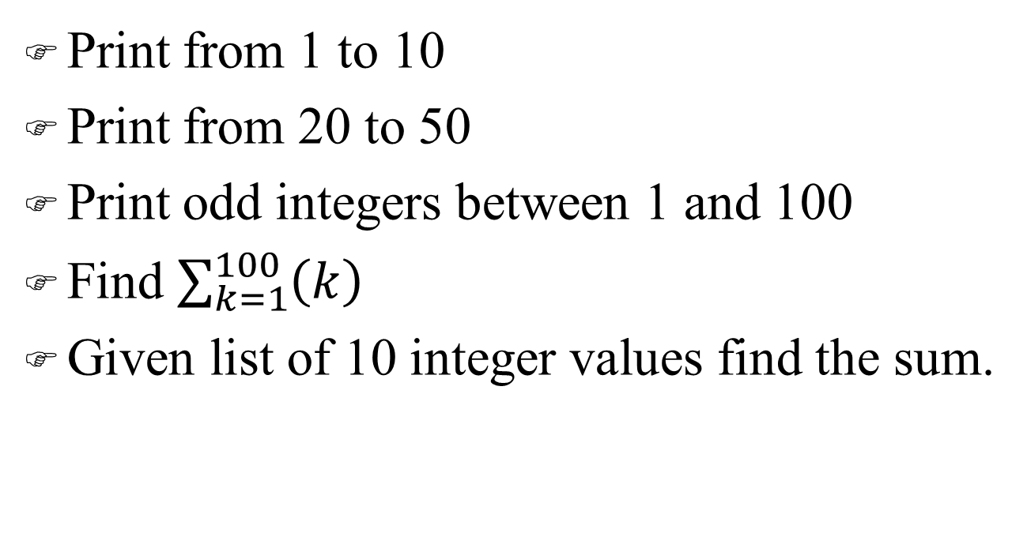
EXAMPLES Counter Loops

Slide 17
EXAMPLES Conditional Loops
Given an integer value num, find the sum of its digits.
For example:
Input is 1024
Output is 7
Given an integer value num, calculate and print the sum of num and its reverse
For example:
Input is 1024
Output is
1024 + 4201 = 5225

Slide 18
Problem: Guessing Numbers
Write a program that randomly generates an integer between 0 and 100, inclusive. The program prompts the user to enter a number continuously until the number matches the randomly generated number. For each user input, the program tells the user whether the input is too low or too high, so the user can choose the next input intelligently. Here is a sample run:
GuessNumberOneTime
GuessNumber
Notes:
GuessNumberOneTime: https://liveexample.pearsoncmg.com/html/GuessNumberOneTime.html
GuessNumber: https://liveexample.pearsoncmg.com/html/GuessNumber.html

Slide 19
Ending a Loop with a Sentinel Value
Often the number of times a loop is executed is not predetermined. You may use an input value to signify the end of the loop. Such a value is known as a sentinel value.
Write a program that reads and calculates the sum of an unspecified number of integers. The input 0 signifies the end of the input.
SentinelValue
Notes:
SentinelValue: https://liveexample.pearsoncmg.com/html/SentinelValue.html

Slide 20
Caution (1 of 3)
Don’t use floating-point values for equality checking in a loop control. Since floating-point values are approximations for some values, using them could result in imprecise counter values and inaccurate results. Consider the following code for computing 1 + 0.9 + 0.8 + ... + 0.1:
double item = 1; double sum = 0;
while (item != 0) { // No guarantee item will be 0
sum += item;
item −= 0.1;
}
System.out.println(sum);

Slide 21
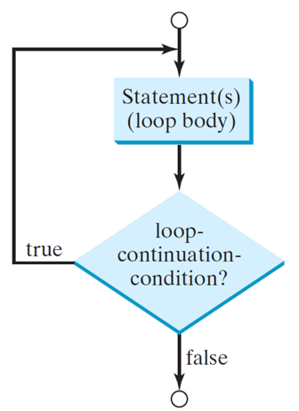
do-while Loop
do {
// Loop body;
Statement(s);
} while (loop-continuation-condition);
Notes:
The chart starts from open circle with downward arrow followed by statement box labeled Statement(s) (loop body) further connected to a decision box labeled loop-continuation-condition if true starting arrow if false connected to an open circle.

Slide 22
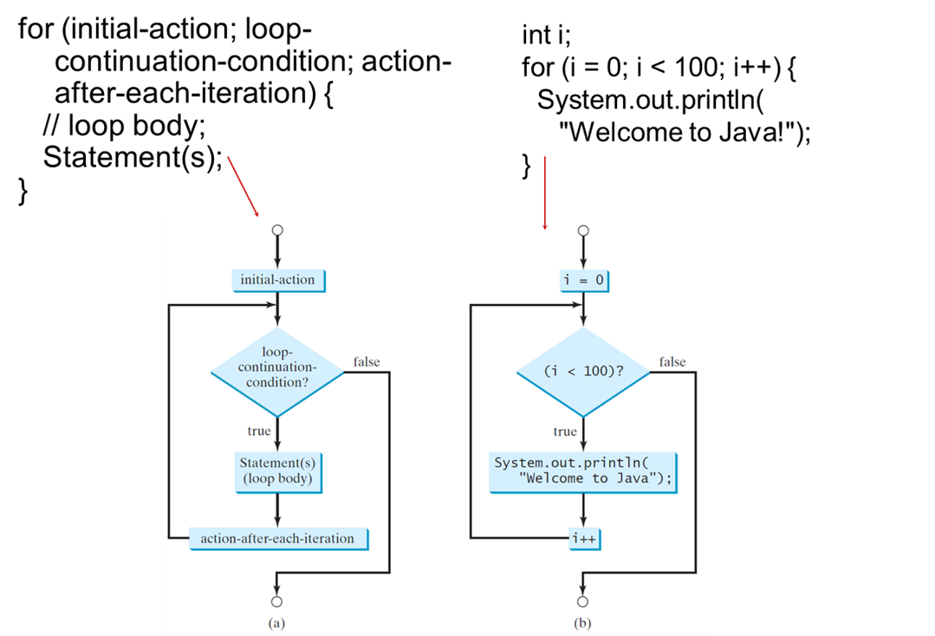
for Loops
Notes:
The chart starts from an open circle with downward arrow followed by statement box labeled initial-action followed by a decision box labeled loop-continuation-condition if false connected to a open circle, if true connected to Statement(s) (loop body) followed by a statement box labeled action-after-each-iteration. An arrow from action-after-each-iteration points to an arrow below initial-action.
An arrow extends from opening quote welcome to Java exclamation closing quote to a flow charts shows loops. The chart starts an open circle with downward arrow followed by statement box labeled i = 0 which is further connected to decision box labeled opening parenthesis i is less than 100 closing parenthesis if false connected to open circle if true connected to System dot out dot println open parenthesis opening quotation Welcome to Java closing quotation closing parenthesis semicolon which is further connected to i + +, i + + is connected to the arrow below i = 0.

Slide 23
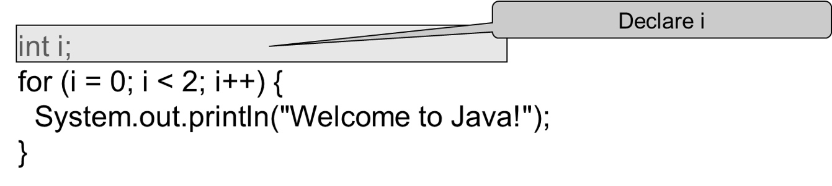
Trace for Loop (1 of 10)

Slide 24
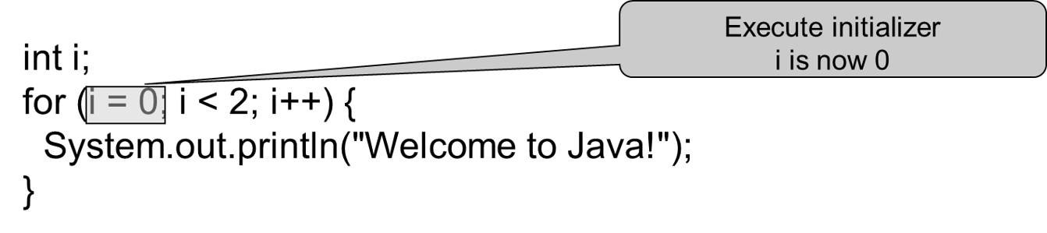
Trace for Loop (2 of 10)

Slide 25
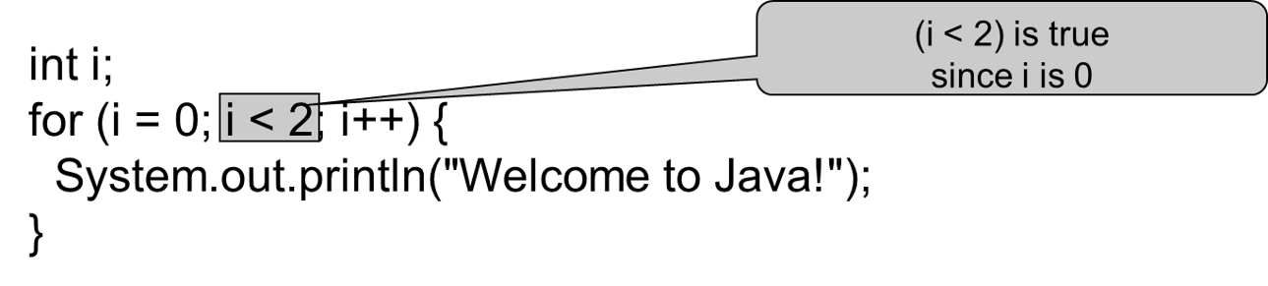
Trace for Loop (3 of 10)

Slide 26
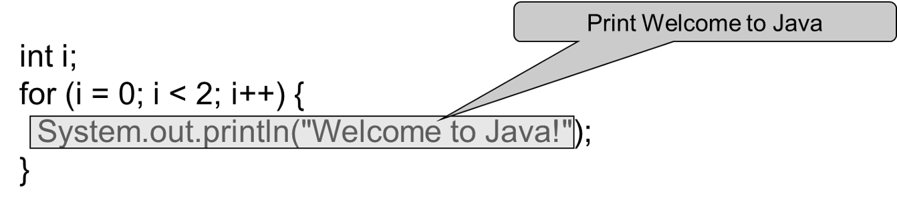
Trace for Loop (4 of 10)

Slide 27
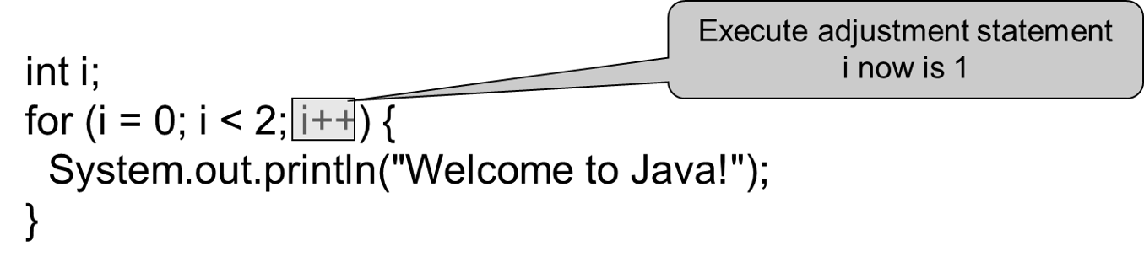
Trace for Loop (5 of 10)

Slide 28
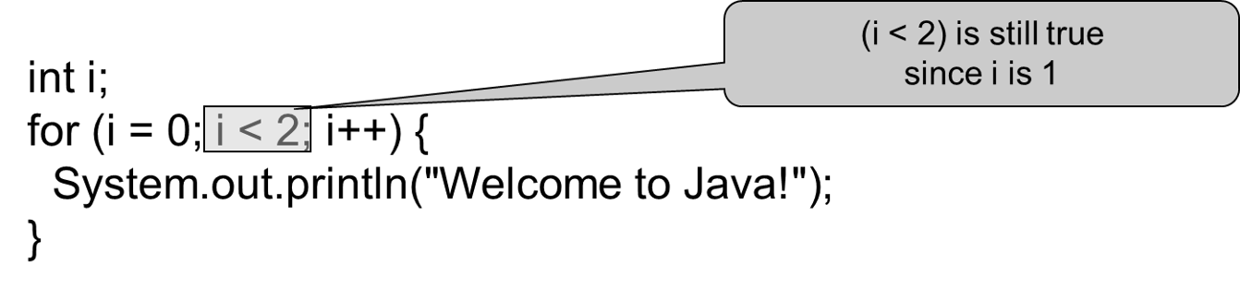
Trace for Loop (6 of 10)

Slide 29
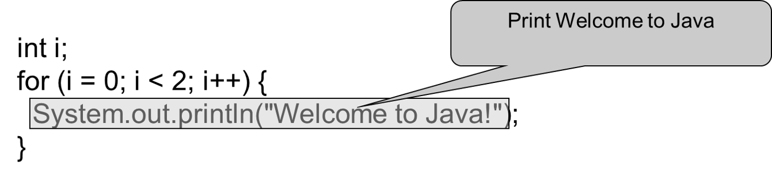
Trace for Loop (7 of 10)

Slide 30

Trace for Loop (8 of 10)

Slide 31
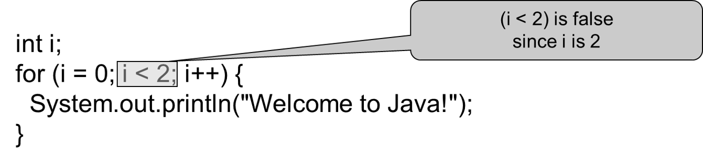
Trace for Loop (9 of 10)

Slide 32
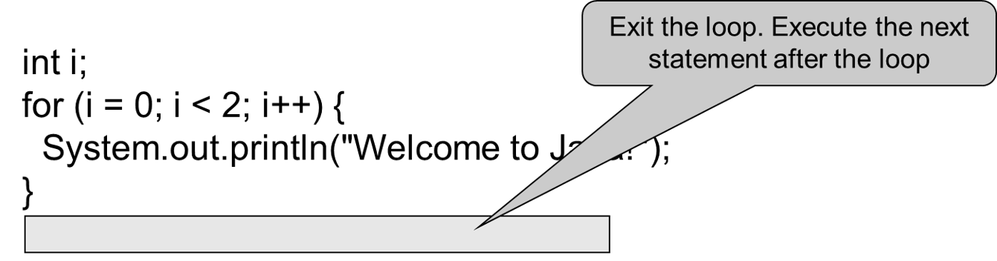
Trace for Loop (10 of 10)

Slide 33
Note (1 of 2)
The initial-action in a for loop can be a list of zero or more comma-separated expressions. The action-after-each-iteration in a for loop can be a list of zero or more comma-separated statements. Therefore, the following two for loops are correct. They are rarely used in practice, however.
for (int i = 1; i < 100; System.out.println(i++));
for (int i = 0, j = 0; (i + j < 10); i++, j++) {
// Do something
}

Slide 34
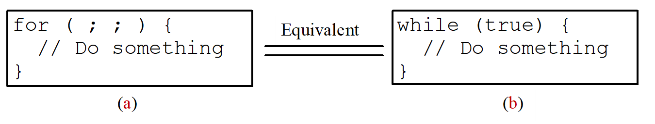
Note (2 of 2)
If the loop-continuation-condition in a for loop is omitted, it is implicitly true. Thus the statement given below in (a), which is an infinite loop, is correct. Nevertheless, it is better to use the equivalent loop in (b) to avoid confusion:
Notes:
Text box on the left reads for opening parenthesis semicolon semicolon closing parenthesis opening braces two forward slash do something closing braces, and the text box on the right reads while opening parenthesis true closing parenthesis opening braces two forward slash do something closing braces.

Slide 35
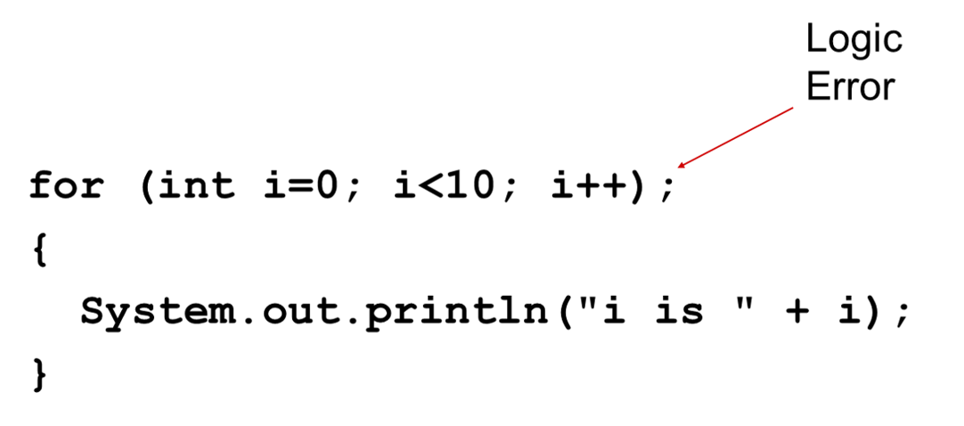
Caution (2 of 3)
Adding a semicolon at the end of the for clause before the loop body is a common mistake, as shown below:

Slide 36
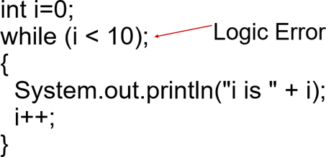
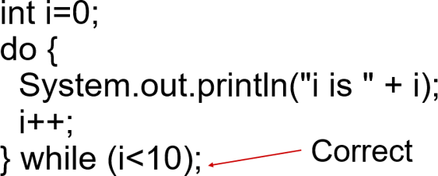
Caution (3 of 3)
Similarly, the following loop is also wrong:
In the case of the do loop, the following semicolon is needed to end the loop.

Slide 37
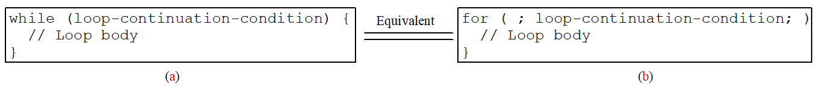
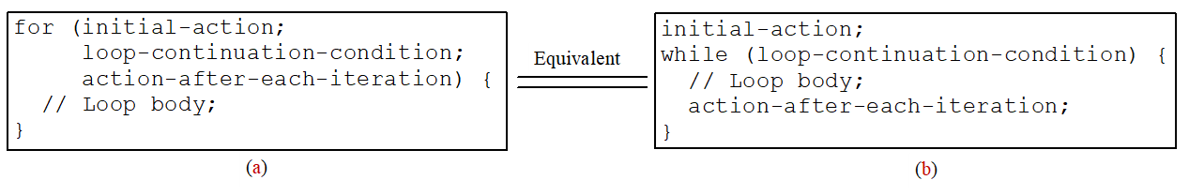
Which Loop to Use?
The three forms of loop statements, while, do-while, and for, are expressively equivalent; that is, you can write a loop in any of these three forms. For example, a while loop in (a) in the following figure can always be converted into the following for loop in (b):
A for loop in (a) in the following figure can generally be converted into the following while loop in (b) except in certain special cases (see Review Question 3.19 for one of them):
Notes:
Text box on the left reads while opening parenthesis loop-continuation-condition closing parenthesis opening braces two forward slash loop body closing braces, and the text box on the right reads for opening parenthesis semicolon loop-continuation-condition semicolon closing parenthesis two forward slash loop body.
Text box on the left reads for opening parenthesis initial-action semicolon loop-continuation-condition semicolon action-after-each-iteration closing parenthesis opening braces two forward slash loop body semicolon closing braces, and the text box on the right reads initial-action semicolon while opening parenthesis loop-continuation-condition closing parenthesis opening braces two forward slash loop body semicolon action-after-each-iteration semicolon opening braces.

Slide 38
Recommendations
Use the one that is most intuitive and comfortable for you. In general, a for loop may be used if the number of repetitions is known, as, for example, when you need to print a message 100 times. A while loop may be used if the number of repetitions is not known, as in the case of reading the numbers until the input is 0. A do-while loop can be used to replace a while loop if the loop body has to be executed before testing the continuation condition.

Slide 39
Nested Loops
Problem: Write a program that uses nested for loops to print a
Multiplication table
 | 1 | 2 | 3 | 4 | 5 | 6 | 7 | 8 | 9
1 | 1 | 2 | 3 | 4 | 5 | 6 | 7 | 8 | 9
2 | 2 | 4 | 6 | 8 | 10 | 12 | 14 | 16 | 18
3 | 3 | 6 | 9 | 12 | 15 | 18 | 21 | 24 | 27
4 | 8 | 4 | 12 | 16 | 20 | 24 | 28 | 32 | 36
5 | 5 | 10 | 15 | 20 | 25 | 30 | 35 | 40 | 45
6 | 6 | 12 | 18 | 24 | 30 | 36 | 42 | 48 | 54
7 | 7 | 14 | 21 | 28 | 35 | 42 | 49 | 56 | 63
8 | 8 | 16 | 24 | 32 | 40 | 48 | 56 | 64 | 72
9 | 9 | 18 | 27 | 36 | 45 | 54 | 63 | 72 | 81

Slide 40
Problem: Finding the Greatest Common Divisor
Problem: Write a program that prompts the user to enter two positive integers and finds their greatest common divisor.
Solution: Suppose you enter two integers 4 and 2, their greatest common divisor is 2. Suppose you enter two integers 16 and 24, their greatest common divisor is 8. So, how do you find the greatest common divisor? Let the two input integers be n1 and n2. You know number 1 is a common divisor, but it may not be the greatest commons divisor. So you can check whether k (for k = 2, 3, 4, and so on) is a common divisor for n1 and n2, until k is greater than n1 or n2.
GreatestCommonDivisor
Notes:
GreatestCommonDivisor: https://liveexample.pearsoncmg.com/html/GreatestCommonDivisor.html

Slide 41
Problem: Predicting the Future Tuition
Problem: Suppose that the tuition for a university is $10,000 this year and tuition increases 7% every year. In how many years will the tuition be doubled?
FutureTuition
Notes:
FutureTuition: https://liveexample.pearsoncmg.com/html/FutureTuition.html

Slide 42
Problem: Predicating the Future Tuition
double tuition = 10000; int year = 0 // Year 0
tuition = tuition * 1.07; year++; // Year 1
tuition = tuition * 1.07; year++; // Year 2
tuition = tuition * 1.07; year++; // Year 3
...

Slide 43
Case Study: Converting Decimals to Hexadecimals
Hexadecimals are often used in computer systems programming (see Appendix F for an introduction to number systems). How do you convert a decimal number to a hexadecimal number? To convert a decimal number d to a hexadecimal number is to find the hexadecimal digits
such that
These hexadecimal digits can be found by successively dividing d by 16 until the quotient is 0. The remainders are
Dec2Hex
Notes:
Dec2Hex: https://liveexample.pearsoncmg.com/html/Dec2Hex.html

Slide 44
Using break and continue
Examples for using the break and continue keywords:
TestBreak.java
TestBreak
TestContinue.java
TestContinue
Notes:
TestBreak: https://liveexample.pearsoncmg.com/html/TestBreak.html
TestContinue: https://liveexample.pearsoncmg.com/html/TestContinue.html

Slide 45
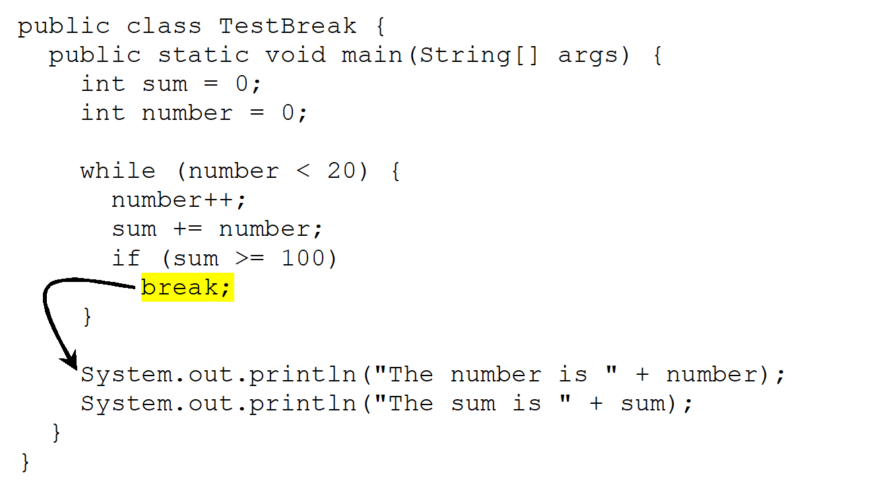
break
Notes:
int sum = 0 semicolon
int number = 0 semicolon
while opening parenthesis number less than 20 closing parenthesis opening braces
number + + semicolon
sum + = number semicolon
if opening parenthesis sum greater than equal to 100 closing parenthesis
break semicolon closing braces
System dot out dot println opening parenthesis opening quote The number is closing quote + number closing parenthesis semicolon
System dot out dotprintln opening parenthesis opening quote The sum is closing quote + sum closing parenthesis semicolon closing braces closing braces
An arrow extends from break semicolon to System dot out dot println opening parenthesis opening quote The number is closing quote + number closing parenthesis semicolon.

Slide 46
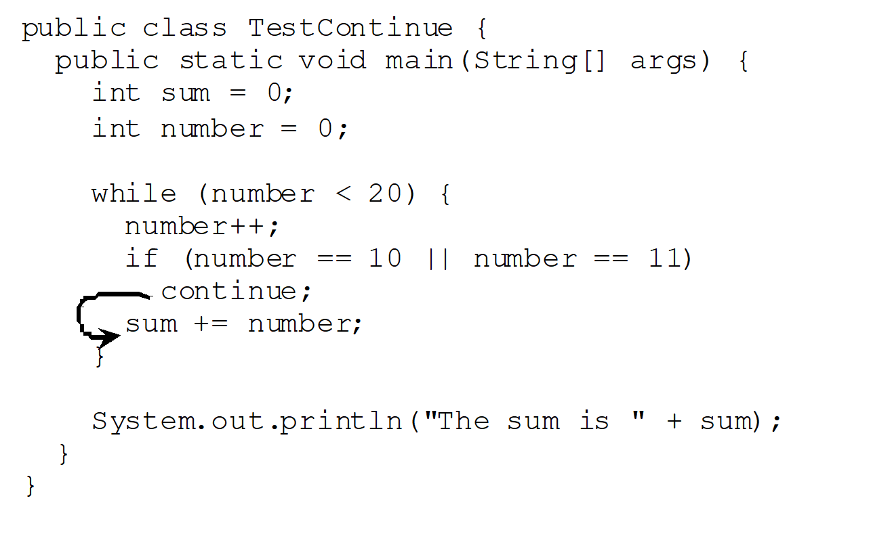
continue
Notes:
int sum = 0 semicolon
int number = 0 semicolon
while opening parenthesis number less than 20 closing parenthesis opening braces
number + + semicolon
if opening parenthesis number == 10 two vertical lines number == 11 closing parenthesis
continue semicolon
sum + = number semicolon
closing braces
System dot out dot println opening parenthesis opening quote The sum is closing quote + sum closing parenthesis semicolon
closing braces
closing braces
An arrow from continue semicolon points to sum + = number semicolon.

Slide 47
Guessing Number Problem Revisited
Here is a program for guessing a number. You can rewrite it using a break statement.
GuessNumberUsingBreak
Notes:
GuessNumberUsingBreak: https://liveexample.pearsoncmg.com/html/GuessNumberUsingBreak.html

Slide 48
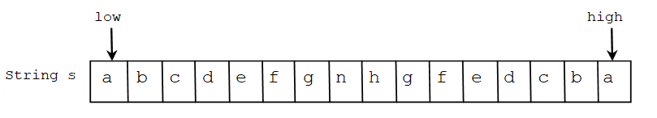
Problem: Checking Palindrome
A string is a palindrome if it reads the same forward and backward. The words “mom,” “dad,” and “noon,” for instance, are all palindromes.
The problem is to write a program that prompts the user to enter a string and reports whether the string is a palindrome. One solution is to check whether the first character in the string is the same as the last character. If so, check whether the second character is the same as the second-to-last character. This process continues until a mismatch is found or all the characters in the string are checked, except for the middle character if the string has an odd number of characters.
Palindrome
Notes:
Palindrome: https://liveexample.pearsoncmg.com/html/Palindrome.html

Slide 49
Problem: Displaying Prime Numbers
Problem: Write a program that displays the first 50 prime numbers in five lines, each of which contains 10 numbers. An integer greater than 1 is prime if its only positive divisor is 1 or itself. For example, 2, 3, 5, and 7 are prime numbers, but 4, 6, 8, and 9 are not.
Solution: The problem can be broken into the following tasks:
For number = 2, 3, 4, 5, 6, ..., test whether the number is prime.
Determine whether a given number is prime.
Count the prime numbers.
Print each prime number, and print 10 numbers per line.
PrimeNumber
Notes:
PrimeNumber: https://liveexample.pearsoncmg.com/html/PrimeNumber.html

Slide 50
Practice Problems

Slide 51
(Find the factors of an integer) Write a program that reads an integer and displays all its smallest factors in an increasing order.
For example, if the input integer is 120, the output should be as follows: 2, 2, 2, 3, 5.

Slide 52
(Sum a series) Write a program to compute the following summation:
$\frac{1}{3}$ +$\frac{3}{5}$ + $\frac{5}{7}$ + $\frac{7}{9}$ + ….. + $\frac{95}{97}$ + $\frac{97}{99}$

